Slide 1
Running Start Student Success
Creating behaviors that support your academic success as a college student.

Slide 2
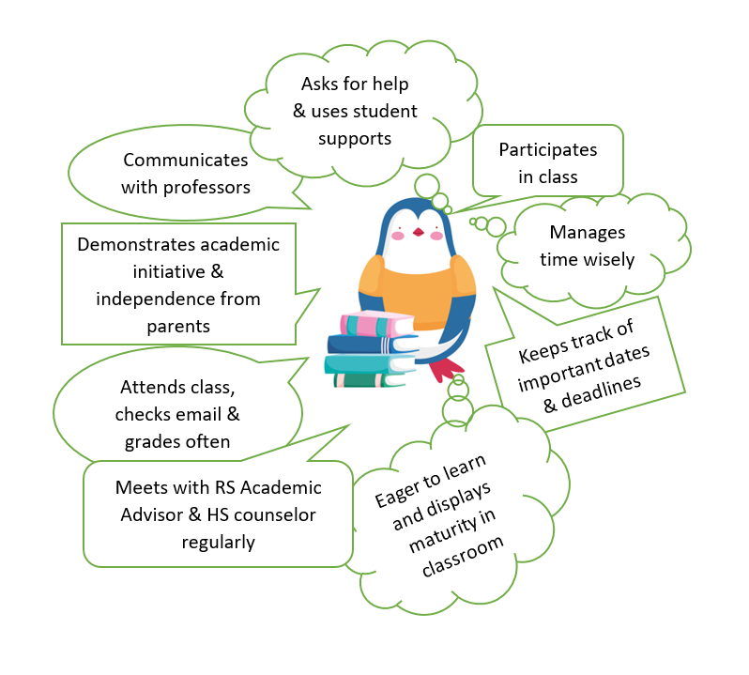
Behaviors of a successful Running Start student:

Slide 3
Understand the difference between High School and College expectations:
High School
College
multiple roles, FERPA, academic success monitored by student
all stuff must be done on time, most studying done on own time, not much review time
manage your own time, syllabus, 10-12 hours per week in class, 10 week quarters, 2 hours of homework per credit outside of class
Communicate absences ahead of time to professor, may influence grade
FERPA, parents have limited access to information, expected to know read course syllabus and know what to do, use professor’s office hours, communicate via email
single role with streamlined schedule and one location, progress monitored by parents/teachers
most work done in class, lots of review, make-ups available
time structured by others, teachers remind, spend 6 hours in class each day, 30 hours a week, 36 week long, 0-2 hours of homework
excused absences by calling office, may/may not influence grade, semester system
HS teachers may contact parents and student directly, available during school hours

Slide 4

Be a good communicator
Communication is expected from you, not your parents. You will be treated like a regular college student and should be the ones communicating with your Running Start Advisors and college instructors.
Meet with your Running Start Advisor and High School counselor regularly to ensure you stay on track with HS graduation and Clark degree requirements.
Get help when you need it! Ask lots of questions. Take advantage of your professor’s office hours.
Write down your questions/concerns before you meet with your Advisor or instructor so that you are prepared.

Slide 5

Be a responsible student.
You are in charge of your academic success, no one else is!
Use your course syllabus and reference it often
Keep track of important dates and deadlines and make note of them in a planner
Check your Clark email daily
Check your grades weekly
Attend class and take good notes every day
Maintain communication with your professors and ask lots of questions

Slide 6

Develop strong time management skills.
Plan for at least 2 hours of homework and studying outside of class per credit you take.
  For example: 15 credits is about 30 hours of homework and studying outside of class each week
Scheduling
  Have a planner to track important dates and deadlines outlined in course syllabus
  Create a schedule that works for you, plan blocks of time for studying, create balance in your life.

Slide 7
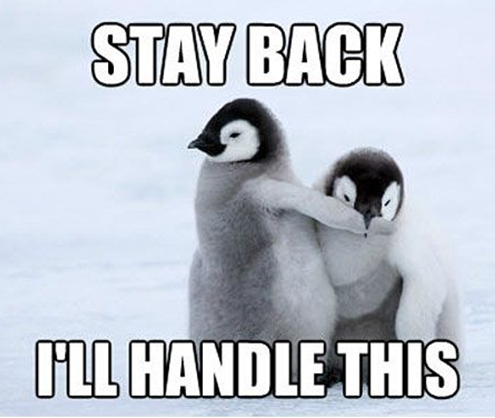
Be a student that takes initiative.
Check out Student Life webpage for upcoming events and ways to get involve
Ask for help when you need it and make use of academic resources available to you: Student support services
Begin with your end goal in mind. Have a clear path of what you want to accomplish at Clark while in Running Start: Career Services
Participate in your classes. Oftentimes, participation is a part of your grade.

Slide 8
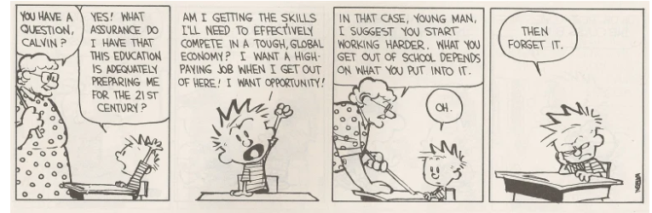
This is your education…OWN IT.

Slide 9

You’ve
Got
This!

